Slide 1
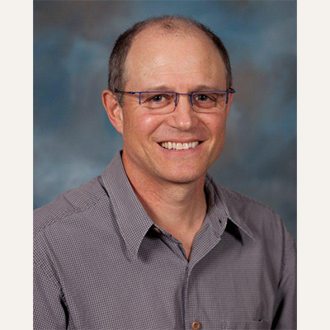
Jonathan Dain
Director of the Florida Natural Resources Leadership Institute
Applied anthropologist by training
Certified mediator & Fellow of the Florida Climate Institute

Slide 2
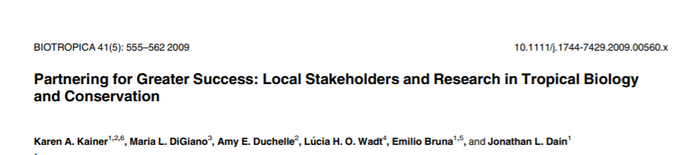
Jonathan Dain
Work focuses on:
Increasing collaboration in extension
Emphasizing knowledge exchange and research relevance for all stakeholders
Overall NR conflict management

Slide 3
Jonathan Dain
Courses:
LAS 6291 Communication and Leadership
LAS 6291 Facilitation Skills
LAS 6291 Conflict Management
LAS 6940 Tropical Conservation & Development Practicum
LAS 6291 Impacting Conservation and Development Policy
jdain@ufl.edu

Slide 4
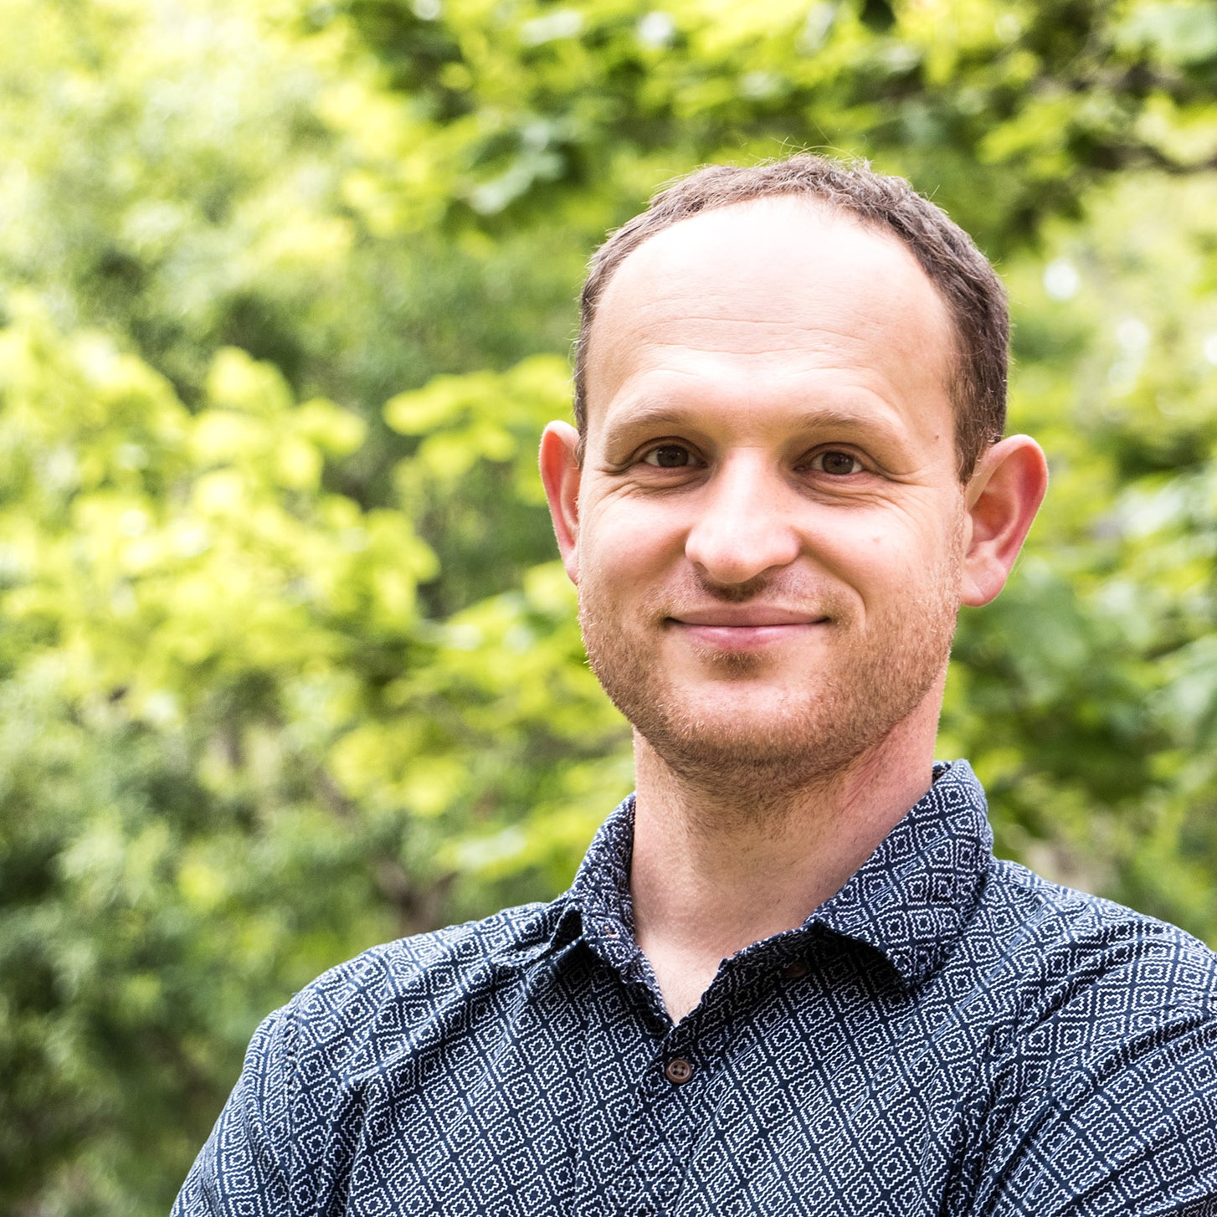
Jiri Hulcr
Forest entomologist in SFRC, focusing on bark beetles and ambrosia beetles
Founding member of Emerging Threats to Forests research group
Maintains cryo-preserved collection of ambrosia beetles and their symbionts
Develops keys and resources for beetle ID

Slide 5
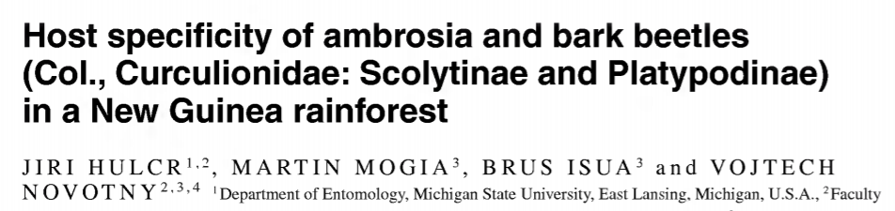
Jiri Hulcr
Research focuses on:
  Evolutionary origins of ecological relationships between beetles and fungi
  Phylogeny of species
  Chemistry of fungal relationships
  Effects beetles have on forests and people

Slide 6
Jiri Hulcr
No courses as currently on sabbatical, but reach out if interested in:
  Forest entomology
  Ambrosia beetle ecology
hulcr@ufl.edu

Slide 7
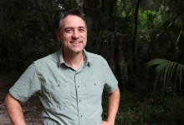
Dan Johnson
Leads the Global Forest Dynamics Lab
Silviculture specialist
Advises students on career paths and serves as a research supervisor

Slide 8
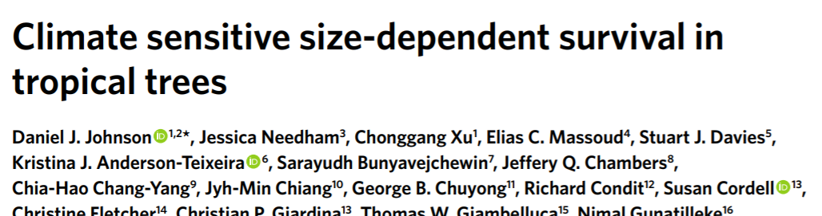
Dan Johnson
Research focuses on:
  How forests respond to change
  Forest regeneration, health, and production
  Using data to analyze forests spatially and temporally

Slide 9
Dan Johnson
In the past has taught courses on:
  Field Ecology
  Forest Ecology and Management
Johnson.daniel@ufl.edu

Slide 10
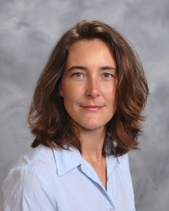
Geraldine Klarenberg
Background in data science and systems modelling
Also has experience in resource management, particularly water issues
Aims to help students and researchers with managing and analyzing datasets

Slide 11
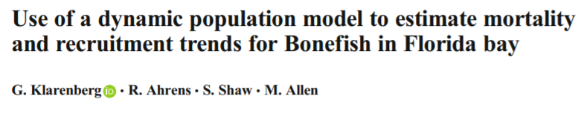
Geraldine Klarenberg
Research interests include:
  Time series analysis
  Causality mechanisms
  Ecosystem services
  Alternative stable states in systems
Past projects:
  Invasive species effects on ectoparasite populations (ticks)
  Developing bonefish population models

Slide 12
Geraldine Klarenberg
Courses being developed focus on:
  Coding, data management, reproducibility
  Data visualization, data preparation, exploratory data analysis techniques
  Potentially numerical ecology and machine learning
gklarenberg@ufl.edu

